Slide 1
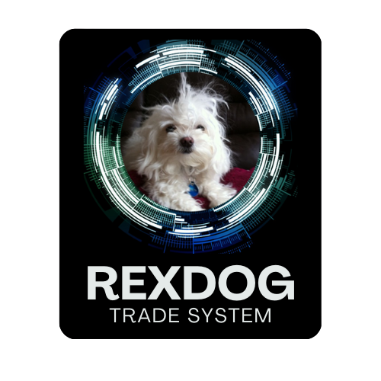
RexDog Trade System (RDTS)
Psychology of Trading

Slide 2
I am not a licensed financial advisor in any way shape or form. This training and everything I say about trading, cryptocurrencies, money, life or anything in general should not be taken as financial advice. Everything I say or write is my opinion. Make sure you do your own research and base all your decisions on what you find yourself. I’m simply stating opinions. I am not giving financial advice, trade advice, or any financial advice in any way whatsoever. Everything I write or state is an opinion.
I AM NOT A FINANCIAL ADVISOR.

Slide 3
To exceed at trading…
You have to master yourself. Who you are. Your strengths, your weaknesses.
You have to also understand how you’re built. How your emotions work. How your body responds to stress, pain, fear, greed, loss, uncertainty, and consistently being wrong.

Slide 4
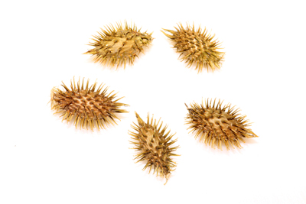
Best Way to Improve
Find complimentary fields of study and find ways it relates to what you want to master…

Slide 5
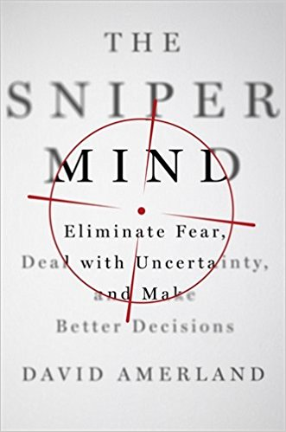
Why This Book…
Trading is about the mind. It’s also about making decisions when you don’t have all the information in a very chaotic environment.

Slide 6
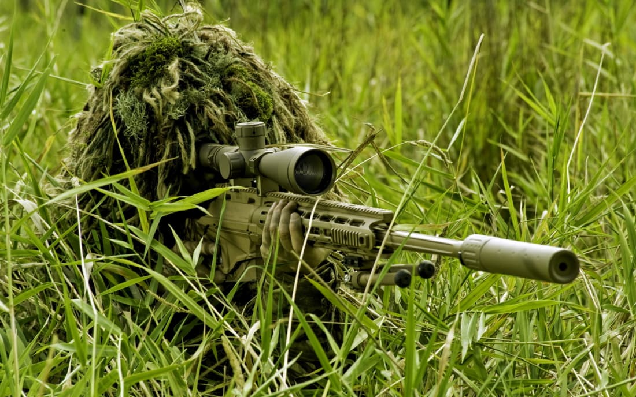
What we can learn from snipers…
They are force multipliers
They’ve developed “deity” like observational skills
They have brains that resist stress (understatement)
They have confidence (even under immense pressure)
Time and time again they accomplish amazing feats

Slide 7
What we can learn from snipers…
Snipers stop only when they are done
It’s not the tools that make the difference, it’s what they do with them
Snipers get the best shot they can get. Not the perfect shot they want
Snipers pick shots for maximum effectiveness
They can go from off to on in a split second…

Slide 8
They accomplish this by following a system…
Control, Analysis, and Action.

Slide 9
It’s about gaining control over…
This Photo by Unknown Author is licensed under CC BY-ND

Slide 10
The same centers of the brain that process physical pain, process mental discomfort.

Slide 11
The fear of failure lights up the same mental centers as the fear of predators does.

Slide 12
It shuts down… seeks to numb itself, transports us somewhere else.

Slide 13
Embrace that, draw strength.

Slide 14
Your biggest adversary…

Slide 15
Successful Trading is about using your intuition without ego or emotion.

Slide 16
Before you can act you must choose.
Before you can choose you must know.
Before you can know you must feel.
And before you can feel you must be trained.

Slide 17
Pillar of Self Belief
Passion
Purpose
Persistence

Slide 18
Passion
If passion exists it creates a shortcut from something that is hard and grueling to something that is beyond a job or a chore.
For the markets
For trading
For being proven wrong consistently
To always be learning

Slide 19
Purpose
Purpose provides the mind the ability to have greater clarity and supports persistence
Why you wake up in the morning
Why you trade (or chose trading)
Why you want to succeed

Slide 20
Persistence
Never stop doing what you are doing…
Whatever the market throws your way– you’re going to make it through
No matter what you’re going to succeed
Realize you’re never going to master the market and will always have another rung to climb

Slide 21
When we believe in ourselves our brains operate differently.

Slide 22
Confidence, even when under pressure, has a way of turning an impossible situation into just another challenge to be met.

Slide 23
True passion requires purpose; both passion and purpose create persistence.

Slide 24
Without knowing who you are and why you do what you do, you can’t hope to control your present or choose your future.

Slide 25
Once you have self belief now you need an approach to trading…

Slide 26
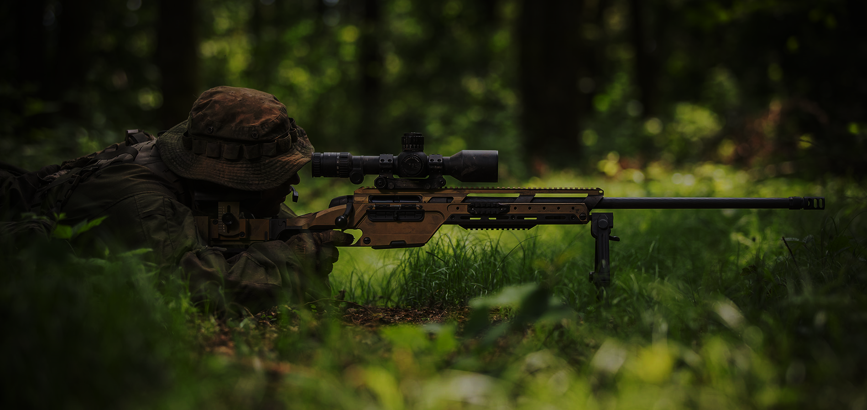
Making good decisions, quickly, especially in the heat of battle, is not easy… your environment and mental state are two of the biggest contributors. The best decision-making is done without really thinking about it—you process the visual and aural information you have in the moment, and make a decision weighted toward success. This makes it somewhat subconscious—you’re not necessarily going through a decision tree in real time in your head, because chances are by the time you run through the plays, the enemy has collapsed on you.

Slide 27
4 Step Approach Snipers Are Trained On…
Plan
Execute
Reassess Plan
Execute

Slide 28
Craves Control
Overthinking
Inhibition of emotions
Avoidance of negative outcomes

Slide 29
How to do this in trading…
Plan your trade
Execute your trade
Reassess trade
Execute on findings

Slide 30
Identify & Observation

Slide 31
“I can’t emphasize enough that sniping is not about shooting every day. It’s about hours and hours of observation,”
Sniper – Page 67
Trading isn’t about consistently opening and closing positions. It’s about observing the market and entering and exiting the market at the right time.

Slide 32
Observation requires patience. The careful collection of facts and their verification so that all the variables are gathered and itemized. Even the ones that are mutable and therefore can create surprises.

Slide 33
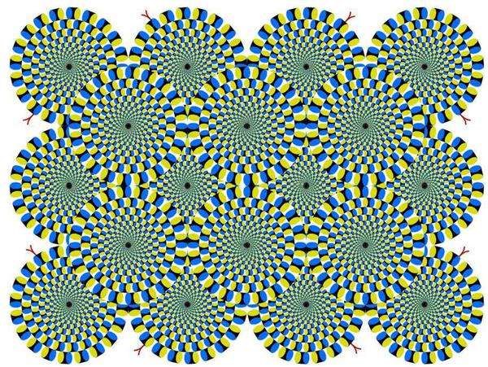
Visual information is used by the brain to create a detailed construct of the world.
That construct becomes the model which allows pattern recognition to take place.
Looking at a chart or watching the market you’re creating a construct of the world.

Slide 34
Observation requires detachment when each element that is noted is factored in, weighed carefully even if the weighing has to happen fast, on the fly.
Observation creates a sense of detachment because it negates the need for immediate action.
Develop the ability to observe the market with complete detachment. No immediate action… even (especially) if you have an active position.

Slide 35
“You hide things in different areas, camouflage them. And then lie observing those who observe them or go past them. You need to understand the reasons people might have spotted some and not others.”
In trading you’re not hiding things, things are already hidden.
You want to look at the market for clues of what others might have spotted. Or reasons why others are noticing things and see if you can benefit from that.

Slide 36
Data & Information

Slide 37
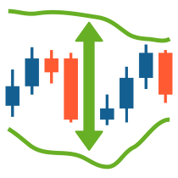
Data is often thought to be information, but that isn’t quite true. Data is a building block. As raw building material, at its point of acquisition it hasn’t yet been shaped, processed, or interpreted.
What you see on a chart is data. It’s a building block of a pattern.

Slide 38
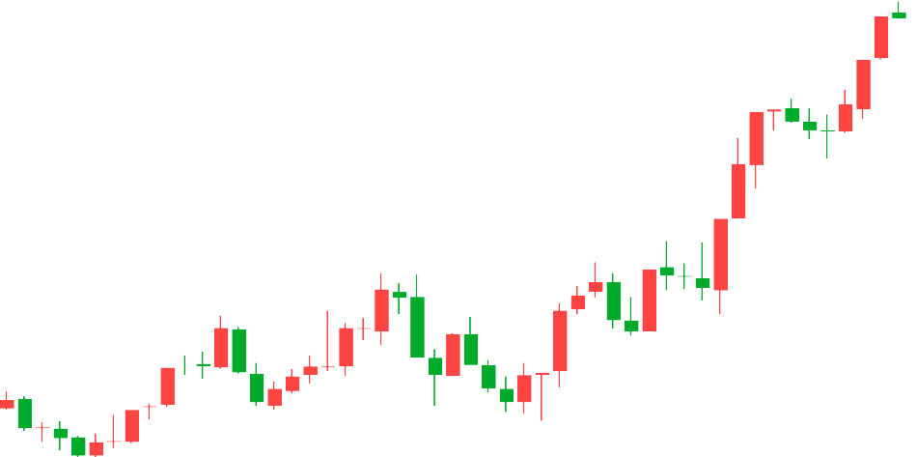
Information, on the other hand requires meaning and context to be useful.
Always have in the back of your mind… the difference between data and information.

Slide 39
Execution

Slide 40
My training took over and I got myself in quickly but calmly into the perfect sniping position.
We follow a set pattern, placing part of our bodies in optimum position in strict order starting with left hand, elbow, legs, right hand and cheek.
Finally, we’re trained to relax and to start to control our breathing focusing solely on the target.

Slide 41
The brain is like a muscle… it needs to be primed.
Exercises or patterns of behavior prime your mind and control your emotions.
Develop a set pattern you do for each and every trade. Track results of the trades and adjust. This pattern will help you remove emotions, fears, greed, and other unhelpful thoughts from your trading decisions.

Slide 42
Shaping
Instead of setting a desired outcome “become more alert,” it’s always easier to break it down into stages, identify how to get immediate feedback so those stages can be assessed, and increase it incrementally.

Slide 43
I want to be better at…
Entries
Exits
Being patient with profits
Getting out of losing trades
Create a step by step approach on how to get feedback.

Slide 44
How Snipers Get Better or Deal with Issues
Identify
Identify the problem
Formulate
Formulate a plan of action to tackle it
Evaluate
Evaluate it
Reformulate
Reformulate it if necessary

Slide 45
I let my losing trades run too long…
Identified the problem
Why do I let my losing trades run to long?
When do I recognize it’s been too long?
Create a plan to tackle it (pick 1)
Set stop losses and stick to them no matter what
Create 2 scenarios per trade that should happen if they don’t I get out of the trade
Set a timeframe for my trades, if they don’t meet my expectations I exit
Will this chosen plan work
On current trades I’m in
On past trades where I made this mistake
On trades I’m looking at now
Reformat Plan

Slide 46
4 Step Process
Identify
Identify the problem
Formulate
Formulate a plan of action to tackle it
Evaluate
Evaluate it
Reformulate
Reformulate it if necessary

Slide 47
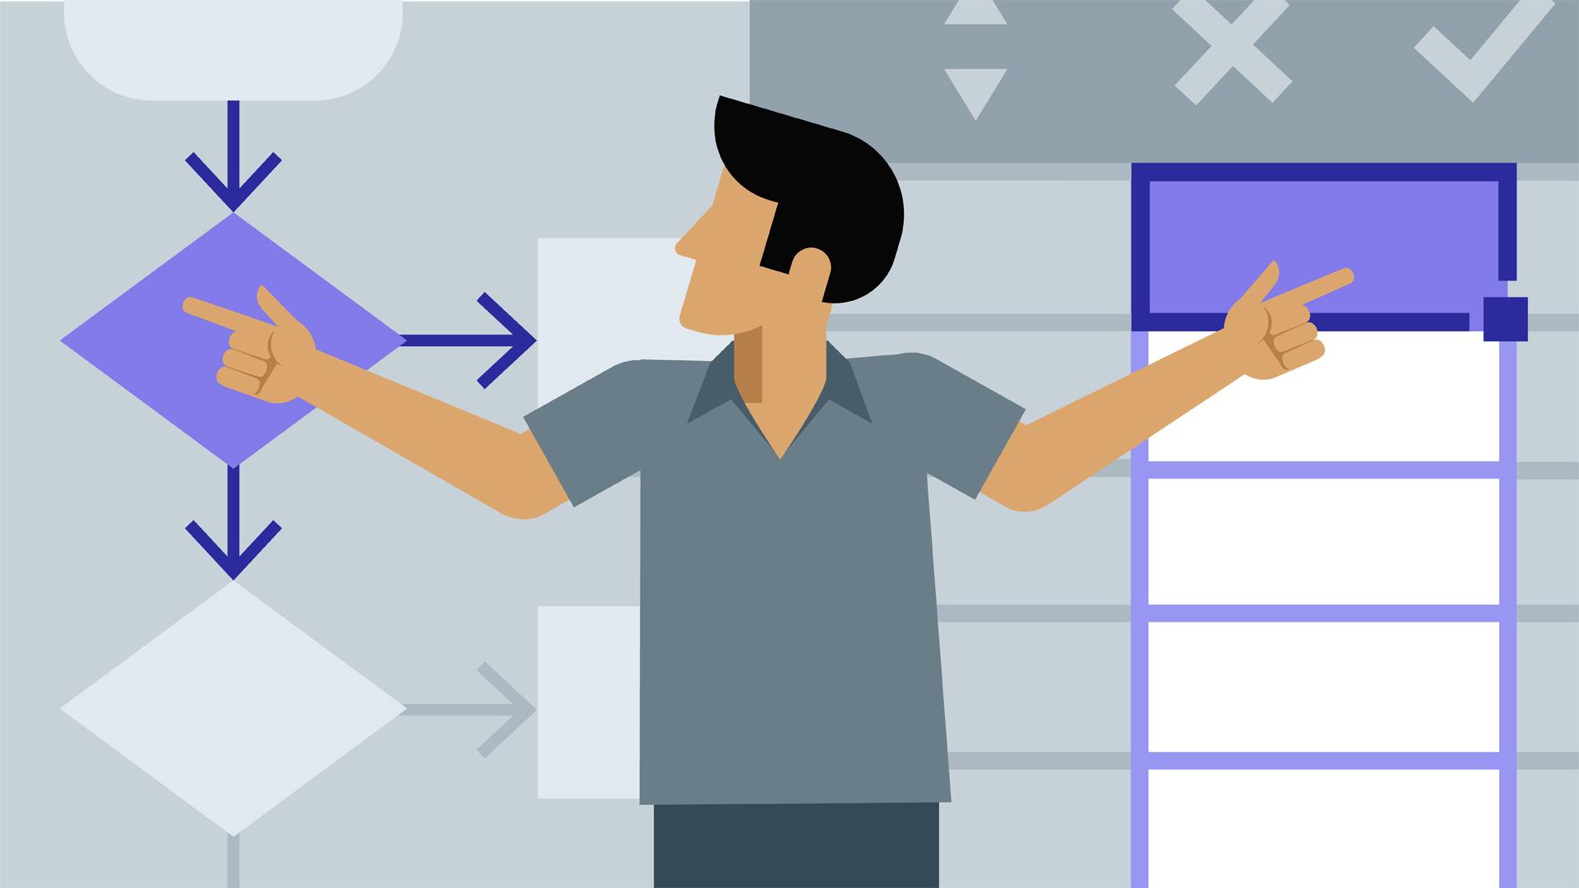
Do extensive internal modeling and role-play.

Slide 48
How This Works in Trading…
Go over every trade you’ve done
The ones that went in your favor try to figure out why
The ones that failed, see how you could have improved
Run scenarios on current trades

Slide 49
Next Steps…
Define your self belief
Daily improve your trading mind
Practice your market observation skills
Create a trade plan your follow that will create your mental flow
Identify your biggest challenges and create a plan to consistently address them

